Slide 1
Customer Purchase & Satisfaction Analysis
Objective:
Analyze customer spending behavior, membership patterns, purchasing activity, satisfaction levels, and city-wise performance to identify actionable business insights

Slide 2
Business Problem
The e-commerce business wants to understand:
Which customer segments contribute the most to revenue?
Which membership type has the highest customer spending?
Which cities generate higher customer value?
How does customer satisfaction relate to purchasing behavior?
Which customers may be at risk of becoming inactive?
Does discount usage appear to be associated with customer satisfaction?
How can the business improve customer retention and engagement?

Slide 3
Business Goal
Use customer data to identify purchasing patterns and provide data-driven recommendations for improving customer retention, satisfaction, and revenue.

Slide 4
Dataset
Dataset Overview
350 customer records
11 columns
Customer IDs range from 101 to 450
Data covers customer demographics, purchases, membership and satisfaction.
Key Variables
Satisfaction Level contains 2 missing values
Remaining fields are largely complete
Data contains categorical, numerical and boolean variables
Customer ID can be used as the unique customer identifier

Slide 5
Data Analysis Process
1. Data Collection
Imported the e-commerce customer dataset.
2. Data Cleaning
Checked missing values
Checked duplicate records
Verified data types
Handled missing satisfaction values
3. Data Transformation
Created customer segments based on membership/spending behavior
Categorized customers based on purchase activity
Prepared data for visualization
4. Exploratory Analysis
Analyzed spending patterns
Compared membership types
Analyzed city-wise performance
Studied customer satisfaction
Examined purchase recency
5. Visualization
Created KPI cards
Bar charts
Donut/pie charts
Column charts
Scatter plots
Tables
6. Dashboard
Combined important KPIs and insights into an interactive dashboard.

Slide 6
Overall Customer Analysis
Key Metrics
The dashboard focuses on:
Total Customers
Total Customer Spend
Average Customer Spend
Total Items Purchased
Average Rating
Average Days Since Last Purchase
Analysis Areas
Customer demographics
Spending behavior
Purchase frequency/activity
Membership performance
Customer satisfaction
Geographic performance

Slide 7
Membership Analysis
Membership Types
The dataset contains three membership levels:
Gold
Silver
Bronze
Observations
Gold members show substantially higher spending and purchasing activity.
Gold customers generally purchase more items per customer.
Gold membership is strongly associated with higher satisfaction and ratings in this dataset.
Bronze customers show comparatively lower spending and lower ratings.
Silver customers fall between Gold and Bronze in spending and purchasing behavior.
Business Insight
Membership level appears to be an important indicator of customer value and engagement.

Slide 8
City-wise Analysis
Cities Covered
New York
Los Angeles
Chicago
San Francisco
Miami
Houston
Observations
San Francisco customers show very high spending and purchasing activity.
New York also shows strong customer spending and high satisfaction.
Los Angeles represents a mid-level spending segment.
Chicago and Houston show comparatively lower spending and ratings.
Miami customers show moderate spending but relatively higher inactivity based on Days Since Last Purchase.
Business Insight
Customer value varies considerably by location, suggesting that marketing strategies can be localized by city.

Slide 9
Customer Satisfaction Analysis
Satisfaction Levels
Customers are categorized as:
Satisfied
Neutral
Unsatisfied
Observations
Satisfied customers generally have higher average ratings.
Satisfied customers tend to show higher spending and greater purchase activity.
Unsatisfied customers generally have lower ratings and lower spending.
Customers with longer periods since their last purchase frequently appear in the unsatisfied group.
Two records have missing Satisfaction Level values and should be handled during data cleaning.
Business Insight
Customer satisfaction is closely associated with engagement, rating and spending behavior in this dataset.

Slide 10
Customer Engagement / Recency Analysis
Days Since Last Purchase
This metric helps identify customers who may be becoming inactive.
Observations
Customers with a low number of days since their last purchase appear more engaged.
Customers with longer gaps between purchases are more likely to require re-engagement.
Miami customers show particularly long purchase gaps in several records.
Unsatisfied customers frequently have longer periods since their last purchase.
Business Insight
Purchase recency can be used as an early indicator for customer retention campaigns.

Slide 11
Discount Analysis
Discount Applied
The dataset records whether a discount was applied to each customer.
Observations
Discounts are frequently associated with Silver and Bronze customers in the dataset.
Many discounted customers still show unsatisfied or neutral satisfaction levels.
This indicates that discounts alone may not guarantee higher customer satisfaction.
Customer experience and product/service quality should also be considered.
Business Insight
Discounts should be used strategically rather than relying on them as the primary method of customer retention.

Slide 12
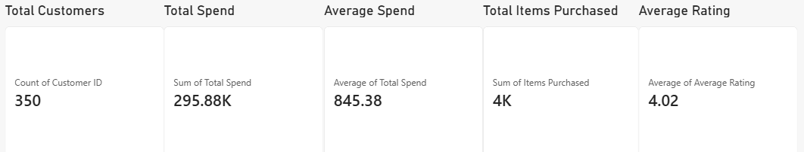
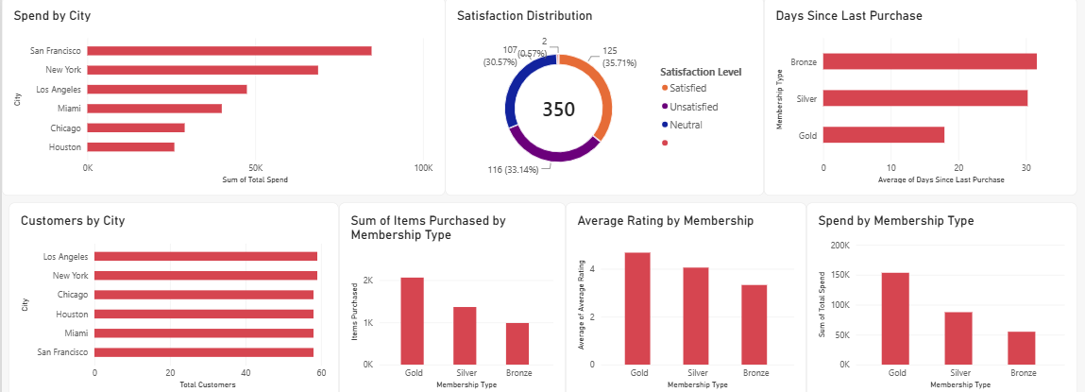
Dashboard

Slide 13
Key Findings
Gold members represent the highest-value customer group based on spending and purchase activity.
San Francisco and New York show strong customer spending and engagement compared with several other cities.
Customer satisfaction is strongly associated with higher ratings and spending in the dataset.
Bronze customers show comparatively lower spending and ratings, indicating an opportunity for targeted engagement.
Customers with longer purchase gaps require attention, as they may be at higher risk of becoming inactive.
Discounts do not consistently translate into higher satisfaction, suggesting that customer experience is also important.
Membership-based segmentation can help the business personalize marketing and retention strategies.

Slide 14
Recommendations
1. Strengthen Gold Membership
Provide exclusive benefits to high-value customers.
Introduce loyalty rewards and early-access offers.
2. Improve Bronze Customer Engagement
Create personalized offers to encourage repeat purchases.
Provide incentives for upgrading membership.
3. Target At-Risk Customers
Identify customers with high Days Since Last Purchase.
Send personalized reminders, offers or re-engagement campaigns.
4. Improve Customer Experience
Investigate reasons behind low ratings and dissatisfaction.
Focus on service quality and product experience, not only discounts.
5. Use Location-Based Marketing
Develop different campaigns for different cities.
Focus on cities with lower customer spending or engagement.
6. Use Data-Driven Personalization
Recommend products based on previous purchasing behavior.
Customize offers according to membership, spending and satisfaction.

Slide 15
Conclusion
The analysis shows that membership type, location, purchase activity, satisfaction and recency are important factors in understanding customer behavior.
The dashboard provides a clear view of customer value and engagement, helping the business identify:
High-value customers
At-risk customers
Geographic opportunities
Satisfaction issues
Membership opportunities
Overall objective: Use customer insights to improve retention, satisfaction and long-term revenue.

